Slide 1
Internet Spaceships are Serious Business: Econophysics of EVE Online
Jonathan Wurtz
Econophysics Presentation
4/16/2015
(Edited for the internet)

Slide 2
Overview of Talk
What is EVE Online?
Datasets used
Power Laws
Correlations
Market Shocks
Market Manipulation
Further Research

Slide 3
What is EVE Online?
Classified as a MMO
Started in 2003
“Sandbox” Gameplay
Rich & Emergent Markets
Localized emergent market hubs
>10k individual items
1-2M daily transactions
Commodities Market

Slide 4
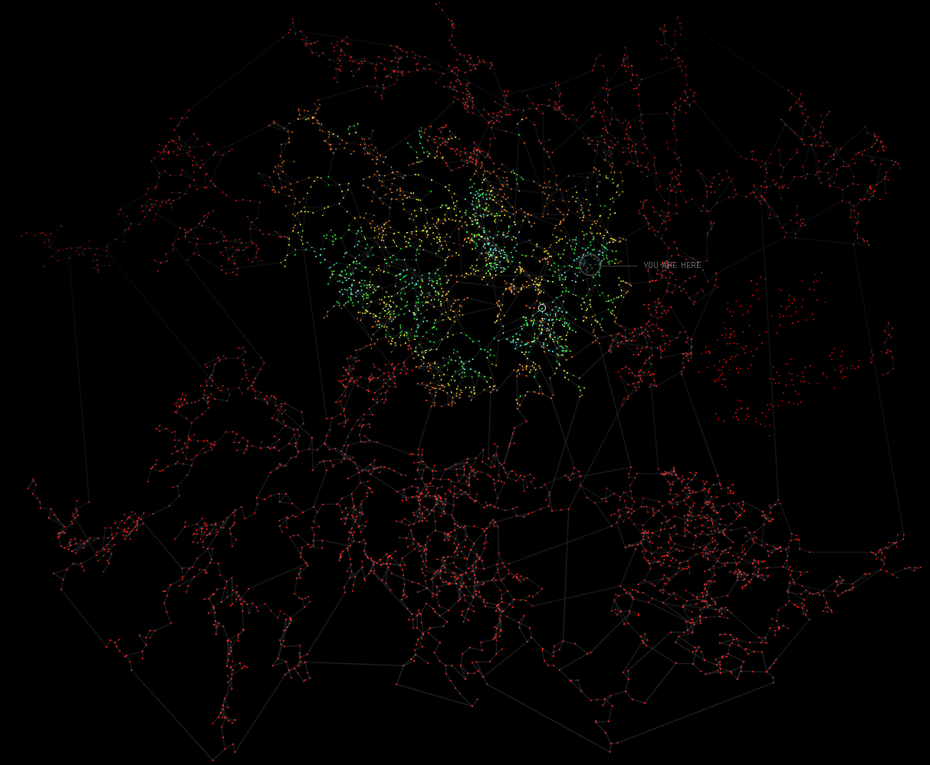
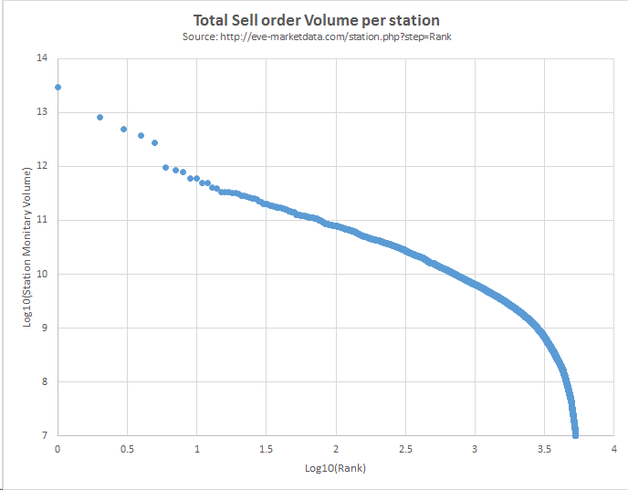
Geography of EVE Online
Dodixie
Amarr
Jita
Hek
Rens
~2,000 locally connected systems
4 Main Trade Hubs emerged in ~2005
At Left: Zipf plot of sell order volume by rank. Jita (the top trade hub) has ~10x more volume then there would be via power law.
In this project: focus on 5 trade hubs, primarily Jita

Slide 5
Mechanics of Trading
Two Positions:
“Asks” and “Bids”
Asks: offer money and wait for players to sell to you.
Bids: offer Items and wait for players to buy from you.
Any item is always sold/bought with the best bidder.
Transaction Tax:
0.75% to place an order
0.80% to complete a transaction (for both parties)
Money: ISK (InterStellar Kredit OR Icelandic Krona)

Slide 6
Data Used
Publicly Available data from Third-Party Website:
https://eve-central.com/
Cache Scraping to collect data from players who offer to help
Incomplete data set!
Data from 2006 – Present
Stored as a data dump; highly uncompressed
~300 Mb/day, or 110 GB/year
First thing: Download & Compress data
Select only orders from 5 main trade hubs
Select only top ~1,000 most popular items
Compress data from all orders to the Best order, and the total order volume
Compressed to ~1.5GB for 300 days of data

Slide 7
Data Used (Continued)
Data points are independent vectors of:
( ItemID, Location, Buy Price, Buy Volume, Sell Price, Sell Volume)
Convert data into a time series:
Create time boxes, fill all empty boxes with nearest left filled neighbor
Multiple points per box are averaged.
5.86
5.83
5.87
5.82
NaN
NaN
5.86
5.86
5.86
5.83
5.83
5.87
5.87
5.87
5.87
5.82
5.82
Time

Slide 8
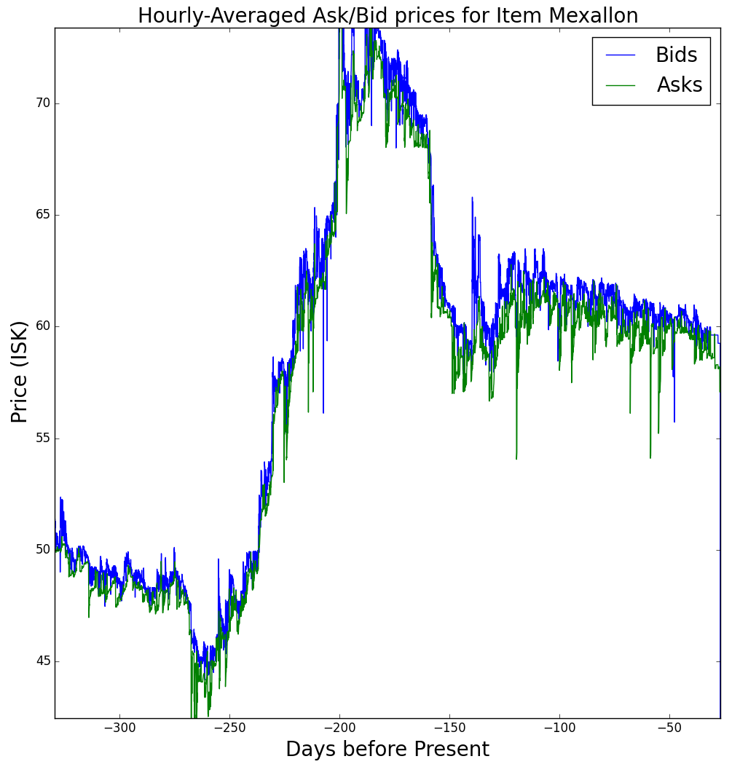
Example Data
Hourly-Averaged data for “Mexallon” (Equivalent to Steel or similar; a basic building material)
54,773 Data points in Jita (7.6 per Hour)

Slide 9
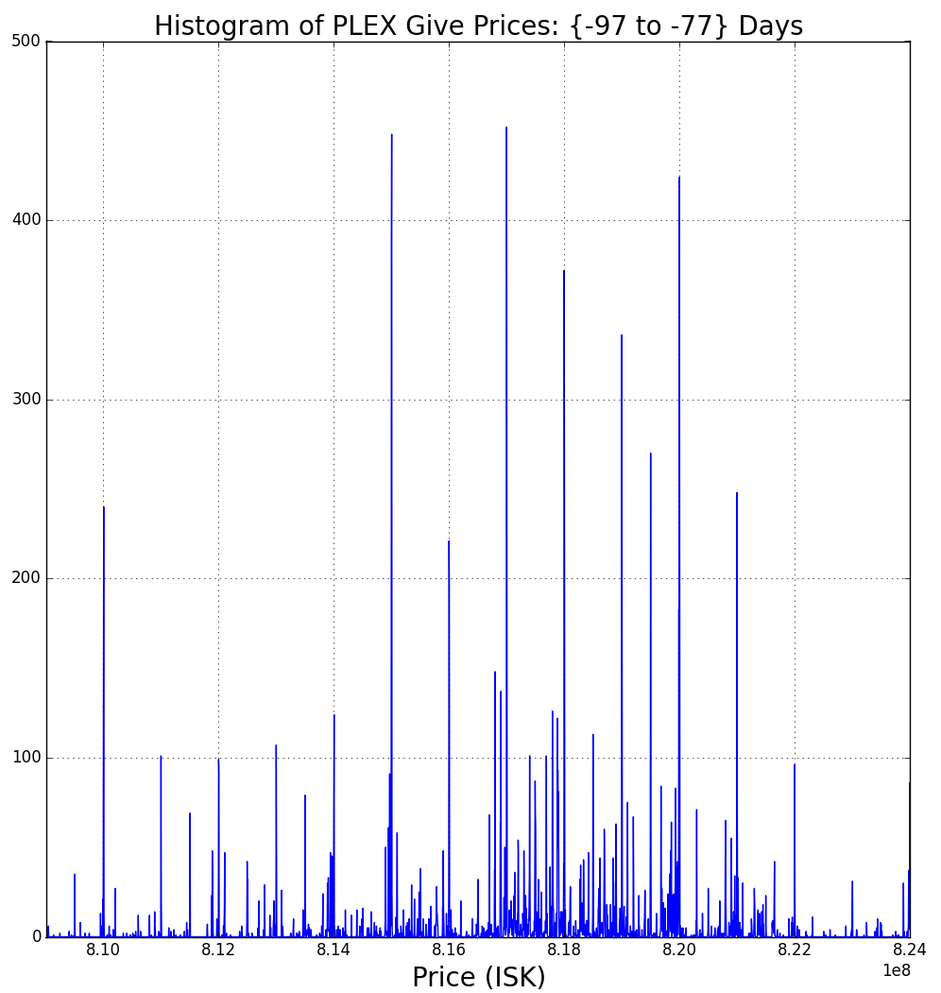
First Result!
Prices tend to settle to round Numbers, aka 810,000,000.00
Insight on mentality of players?
Market Inefficiencies!

Slide 10
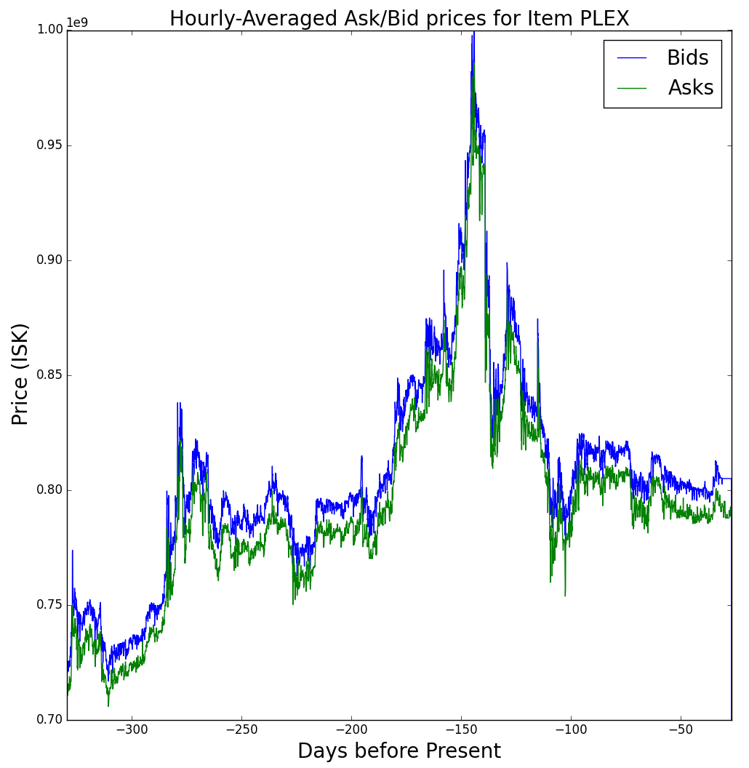
Further Exemplified: “PLEX Inflation”
December 2014: the PLEX speculation bubble
Prices rose from 500m in 2012 to >800m in 2014
Sell Prices touched 1,000m, which caused the bubble to burst, just because of the number.

Slide 11
Is this system similar to real Markets?
Power Law Returns?
Efficient Market Hypothesis?
Cross-Market Correlations?
Trade-Hub Emergence?
Cross-Item Correlations?
Market Shocks?
How can I make a profit?

Slide 12
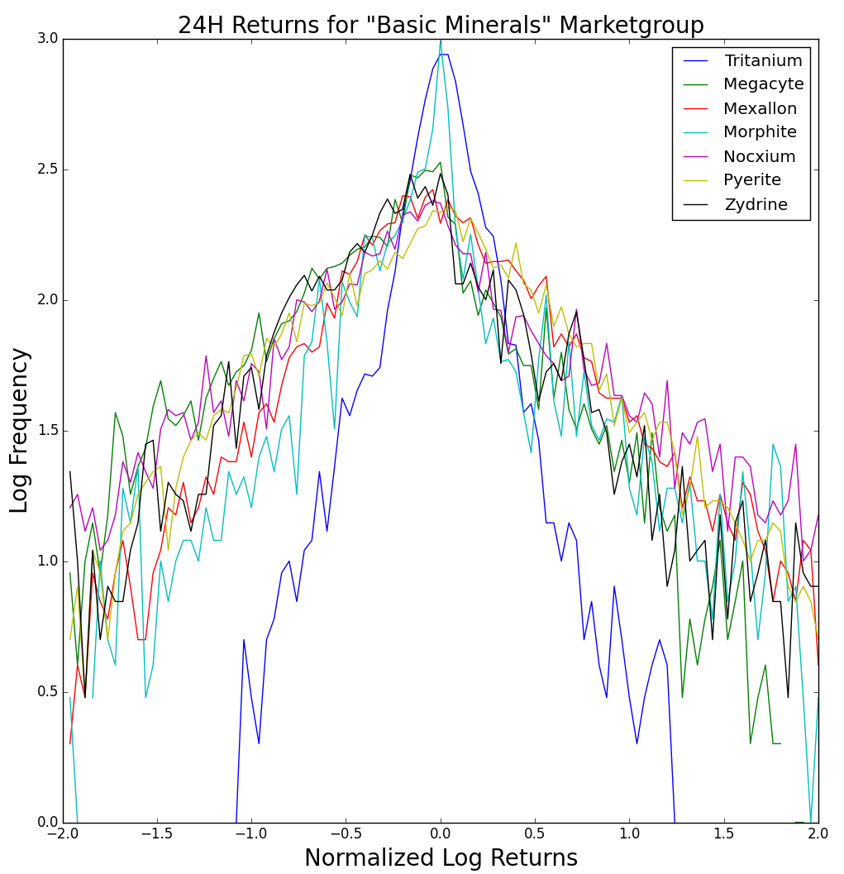
Power Law Returns
Looking at 24h returns for different items
On right: “Basic Minerals” market group; Equivalent to basic commodity prices (steel, wheat, etc)
Recover a power law as is expected
“Tritanium” had an anomalous event in 12/14 which messed up normalization
Less active items are anomalous around 0 returns

Slide 13
Efficient Market Hypothesis
“There are no chances for Arbitrage in the system”
All autocorrelations are zero for non-zero time shifts
Inter-item correlations are the same, or small

Slide 14
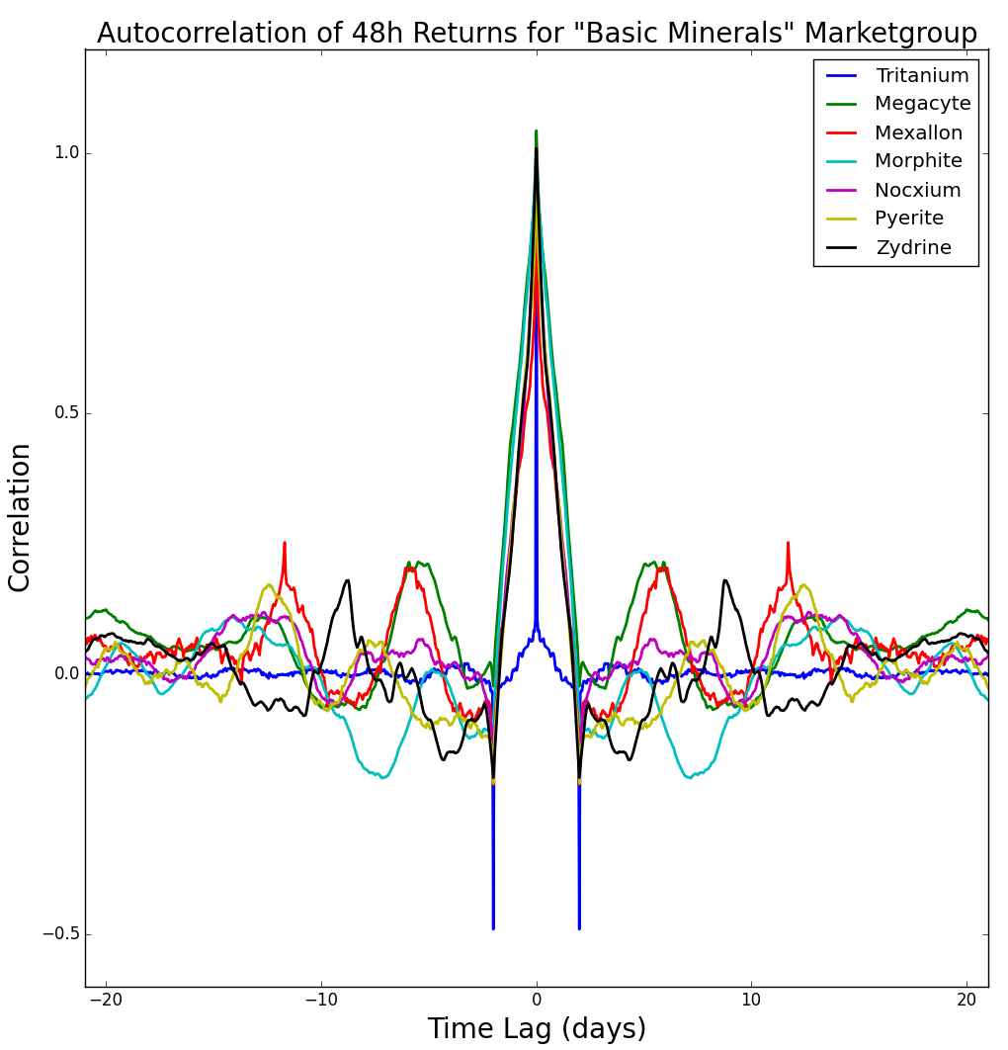
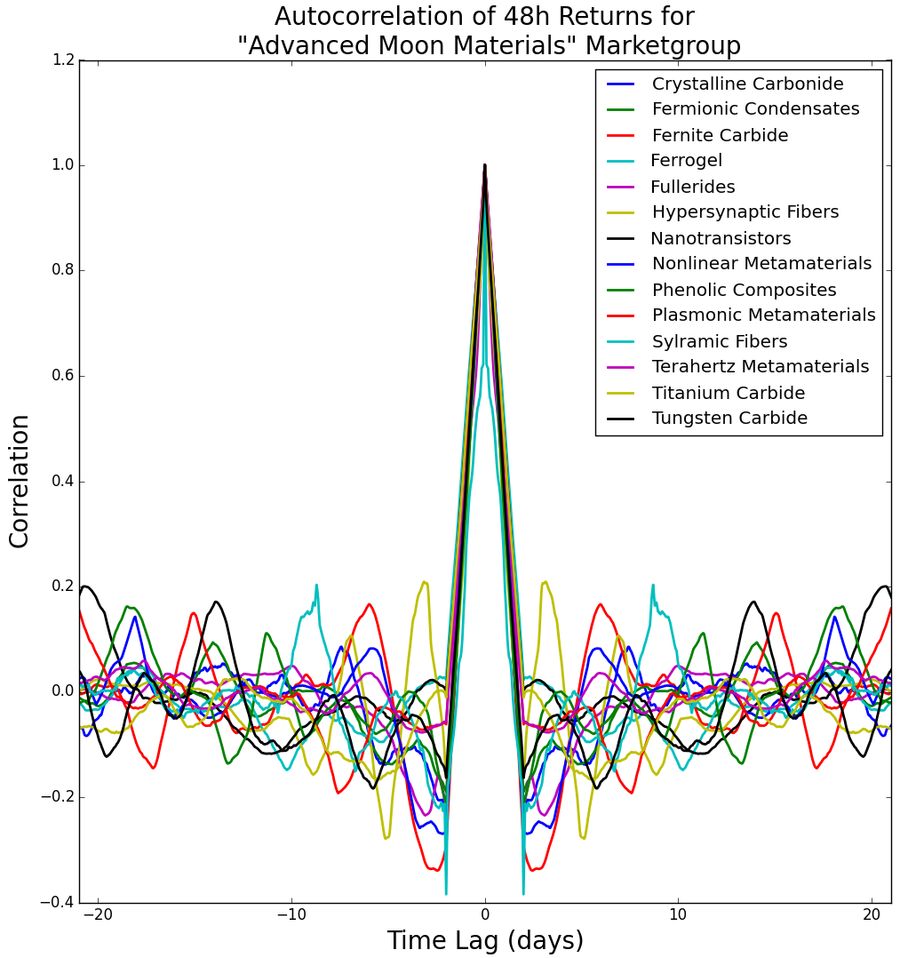
Autocorrelations of Returns
48 Hour returns with 1 hour shift means there is some “blurring”
Daily timescales are “Natural” for this system; the market is normally slow.

Slide 15
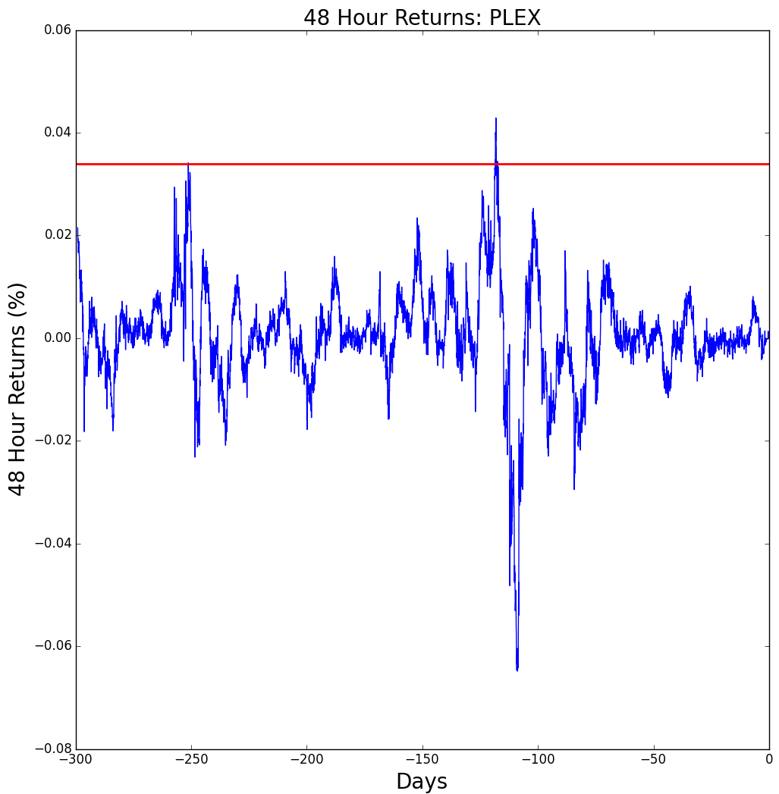
Does this violate the Efficient Market Hypothesis ?
NO: there is a Transaction Tax which allows for small correlations!
Suppose you knew that an item was going to increase in value in the next 48h. How do you profit?
Most fast Fluctuations are below transaction tax threshold: Not scale free!
Purchase at Low Value | -$800,000,000.00
Transaction Tax (1.7%) | -$13,600,000.00
Sell 48h later (+2.0%) | +$816,000,000.00
Transaction Tax (1.7%) | -$13,872,000.00
Total Profit | -$11,472,000.00

Slide 16
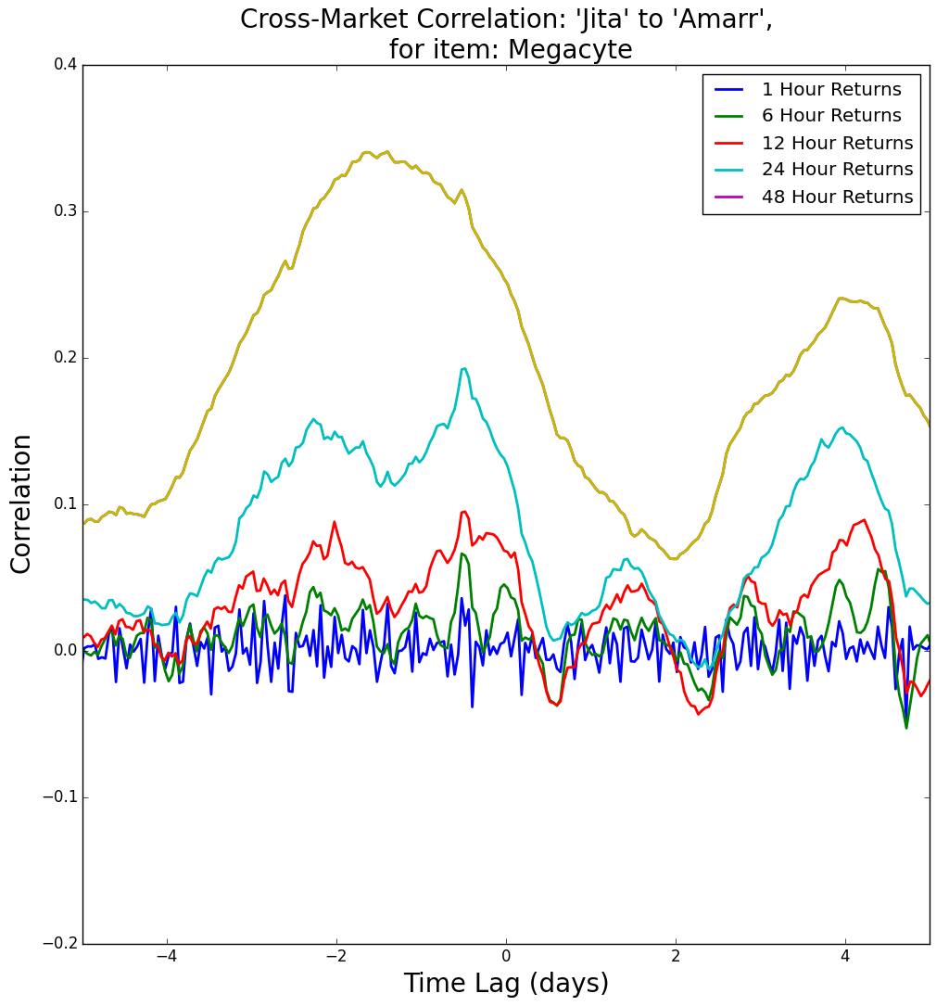
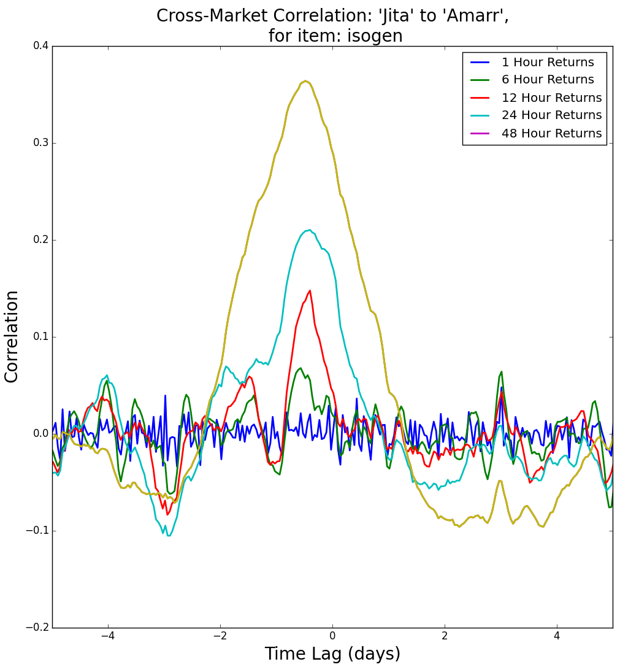
Cross-Market Correlations
Are there “Leader” and “Follower” markets?
5 main trade hubs! Cross-correlate returns for time series!
Jita (the largest trade hub) is consistently the leader of price changes

Slide 17
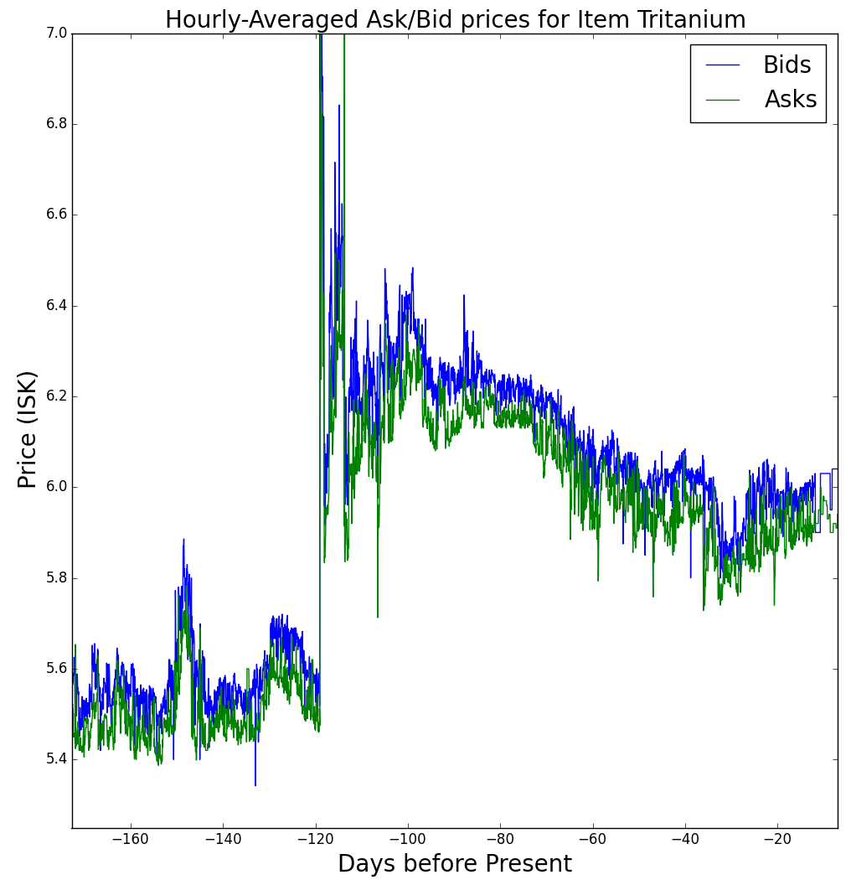
Market Shocks and Speculation
Sometimes the game developers announce changes to the game
Equivalent to the Federal reserve changing interest rates, or companies announcing new products.
Announcements range from balancing ship classes to modifying mineral manufacturing ratios.
Prices can rapidly change to settle on a new optimal value, on timescales of hours!
Markets can be small enough to allow for manipulation by players

Slide 18
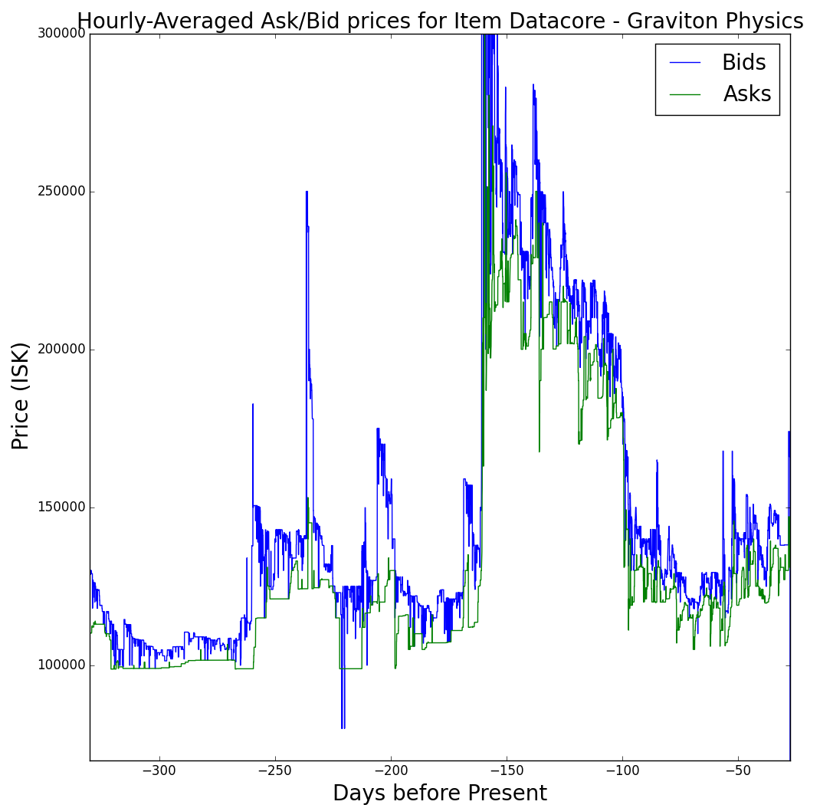
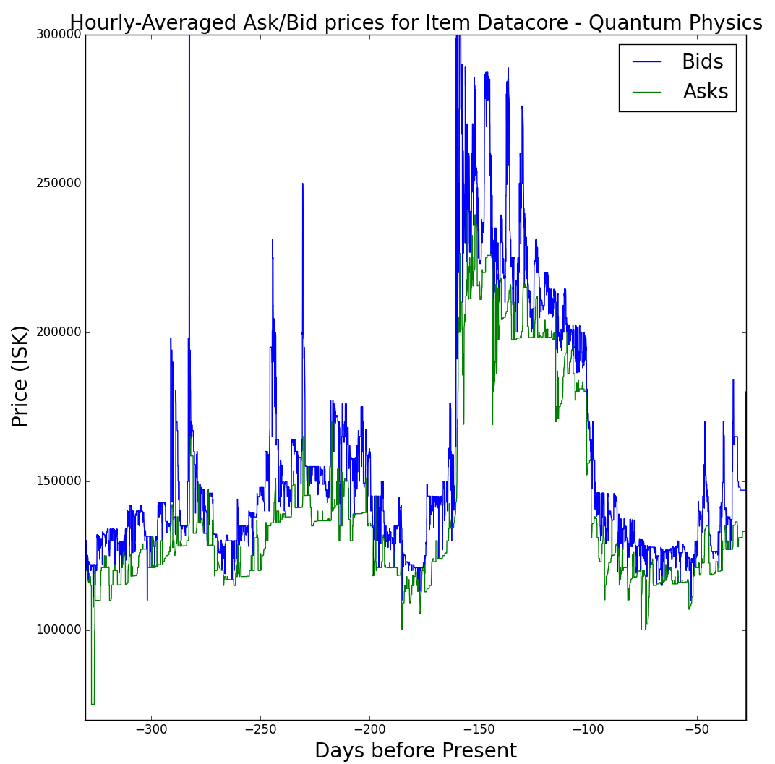
Market shocks are common
“Invention” Changes on 11/1/2014 (Some results below)
Proposed Mineral changes on 4/1/2015: Some prices double
Anti-Botting Mechanism late 2014: Partially responsible for PLEX crash

Slide 19
Market Manipulation
The basics are simple:
Buy a large volume of an item to push up the price
Re-list all purchased items at the higher price
Sell all items at a higher price for a profit
Hope you sell everything before prices return to normal!
How does a Transaction Tax effect Manipulation?
How can I use this information to make a profit?

Slide 20
Some Basics…
Volume Response
Time Response
Definitions:
γ– Price-Volume relationship [ Percent per Item ]
τ – Characteristic System Time [ Time ]
V- Volume – [ Items per Time ]
T- Transaction Tax [ Percent ]
Nc – Charicteristic Itemscale: τV
(Board Work goes here)
Conclusion: Transaction tax creates stability and reduced volatility in the system: There is a “Threshold” set by transaction tax which a manipulation must be above.

Slide 21
Continued…
Taking the T->0 Limit:
γ->0 means “Large Market”: prices don’t change
τ->0: “Efficient Market”: prices quickly re-stabilize
$N/{Nc}$->0: “Large Market”- one person can’t influence
Conclusion: Transaction tax creates stability and reduced volatility in the system: There is a “Threshold” set by transaction tax which a manipulation must be above.
$$T<\text{γ}\text{N}\text{(1-}\text{exp}\text{(}N/{Nc})$$

Slide 22
More things to explore!
Trade Hub Emergence
System response to shocks
Price-Impact Function
Market Manipulation
Material-Product Correlations
More impacts of taxation
Exploiting Market Inefficiencies!
How can I make a profit?

Slide 23
Thank You!
Eðvald I. Gíslason, Analyst CCP Games
Antonio, Chester & Dr. Stanley
http://www.eve-central.com
http://www.eve-markets.com
http://imgur.com/gallery/jOfk1
All art used is from CCP Games

