Slide 1

Network theory and its applications in economic systems
-- Final Oral Exam
Xuqing Huang
Advisor: Prof. H. Eugene Stanley
Collaborators: Prof. Shlomo Havlin
  Prof. Irena Vodenska
  Prof. Sergey Buldyrev
  Prof. Huijuan Wang
        Fengzhong Wang, Dror Kenett
        Jianxi Gao, Qian Li, Shuai Shao, Nima Dehmamy

Slide 2
Overview: What did I do for the past six years?
Interdependent networks theory:
Robustness of interdependent networks under targeted attack [ PRE(R) 83(6) 065101 (2011) ].
Robustness of interdependent clustered networks [ EPL 101 18002 (2012) ].
Robustness of partially interdependent network of clustered networks [ arXiv].
Bipartite networks: increasing survival threshold leads to a change of from second order to first order phase transition [ working paper ].
Percolation of local attack on interdependent networks [working paper].
Apply network theory to model economic systems:
Identifying influential directors in US corporate governance network [ Phys. Rev. E 84 046101 (2011) ].
Cascading failures in bipartite Graphs: model for systemic risk propagation [ Scientific Reports 3, 1219 (2013) ].
Partial correlation analysis of global stock markets [ working paper ] .
Notes:
Study and complete the interdependent networks theory. Enjoy the beauty of simple analytical results.
The second part, I worked on modeling economic systems with empirical data.
2013: 5 banks failed
2012: 51 banks failed
2011: 91 banks failed
2010: 155 banks failed
2009: 140 banks failed
2008: 25 banks failed
2000-2007: 27 banks failed

Slide 3
Outline
Cascading failures in interdependent networks
  Topic I: targeted attack
  Topic II: clustering
  Conclusion
Cascading failures in financial systems
  Bipartite networks model for banking system
  Conclusion

Slide 4
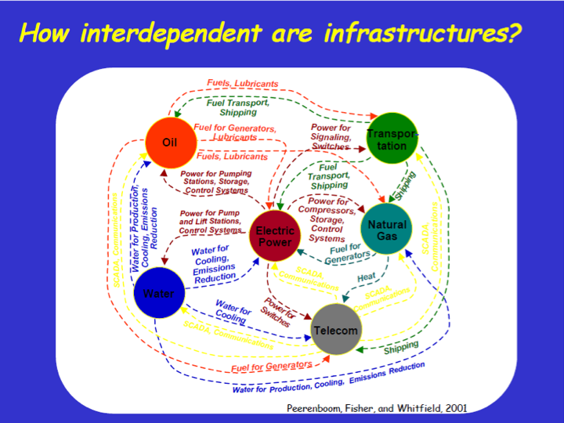

Motivation
Notes:
Not only that, different complex systems can also be interdependent on each other. That’s why we would be interested in interdependent networks.

Slide 5

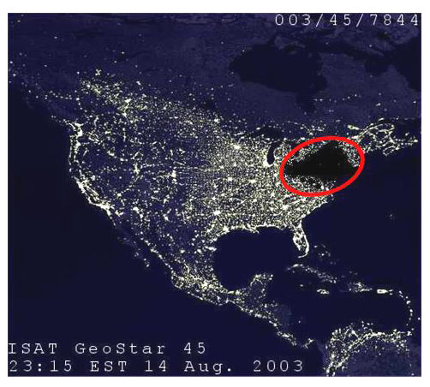

Motivation
Cascading failure:
failure of a part of a system can trigger the failure of successive parts.
Infrastructures (power grids).
“…high-voltage power lines … went out of service when they came in contact with "overgrown trees". The cascading effect that resulted ultimately forced the shutdown of more than 100 power plants” ---- US-Canada Power System Outage Task Force Final Report
Financial systems.
Notes:
Cascading failure: failure in a system of interconnected parts in which the failure of a part can trigger the failure of successive parts.
As our human civilization develops and technology advances, our society has become a more and more interconnected system. Thus systemic risk of complex systems (cascading failure) has become an increasing risk that we need to study and prevent.
For example the financial systems. Everyone should be aware of the European sovereign debit crisis. Because these countries are holding each others sovereign debt, one country default will definitely affects the other countries.
Cascading failure is also very common in infrastructures, like in power grid. Black out caused by an overheated transmission line.
The crisis was the second record-breaking outage in two days. India's northern grid failed Monday, leaving 370 million people powerless for much of the day, in a collapse blamed on states that drew more than their allotment of power.
At 1:05 p.m. Tuesday, the northern grid collapsed again, energy officials said. This time, it took the eastern grid and the northeastern grid with it. In all, 20 of India's 28 states — with double the population of the United States — were hit in a region stretching from the border with Myanmar in the northeast to the Pakistani border about 3,000 kilometres (1,870 miles) away.

Slide 6
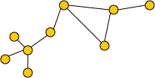
Motivation
Networks
– the natural language describing interconnected system.
Node, link, degree.
Degree distribution: .
Generating function: .
e.g. Erdos-Renyi networks:
Random Networks
Nodes with generating function randomly connect.
and size fully describe a random network.
“Two random networks are the same” means “two random networks’ generating functions are the same”.
Notes:
To study those interconnected systems, complex networks becomes the natural language. Networks consist of nodes and links, degree is defined as the number of links connected to a node.
In the past 15 years, physicists have been actively participated in the research of complex networks. Percolation has become common to study the giant cluster and critical phenomena in the complex systems. Problem of robustness like cascading failure or epidemic problems, like disease spreading.
Percolation: porous media, isolating system & conducting system.
However, almost all work had been focused on single networks before 2010. And that leads to one of research interest: develop theoretical framework to study interdependent networks.

Slide 7
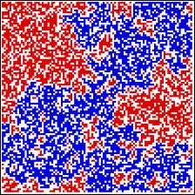
Motivation
Percolation theory
– is widely applied to study robustness and
epidemic problems in complex systems.
Interdependent networks
  Needed in life.
  Until 2010, most research have been done on single networks which rarely occur in nature and technology.
  New physics arise when interaction is considered.
  Analogy: Ideal gas law←→ Van de Waals equation
Notes:
To study those interconnected systems, complex networks becomes the natural language. Networks consist of nodes and links, degree is defined as the number of links connected to a node.
In the past 15 years, physicists have been actively participated in the research of complex networks. Percolation has become common to study the giant cluster and critical phenomena in the complex systems. Problem of robustness like cascading failure or epidemic problems, like disease spreading.
Percolation: porous media, isolating system & conducting system.
However, almost all work had been focused on single networks before 2010. And that leads to one of research interest: develop theoretical framework to study interdependent networks.

Slide 8
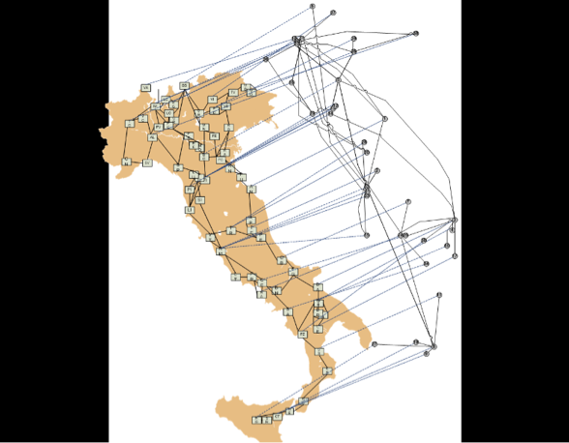
I: Cascading failures in interdependent networks
Blackout in Italy (28 September 2003)
Communication
SCADA
Rosatoet al
Int. J. of Crit.
Infrastruct. 4,
63 (2008)
Power grid
Notes:
To give you a intuitive feeling of interdependent networks, let’s look at this communication – power grid interdependent network.
The nodes in SCADA communicates with other power plants and control its corresponding power plant to keep the voltage stable in the power grid. So the functioning of power grid replies on the functioning of SCADA nodes, and the functioning of SCADA nodes replies on the power supply of power plants.

Slide 9
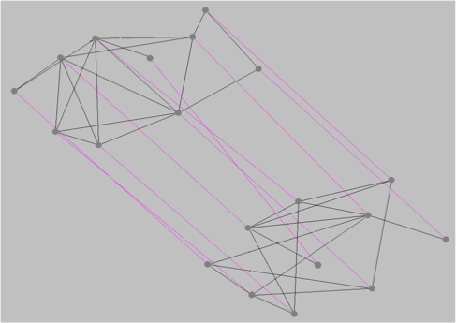
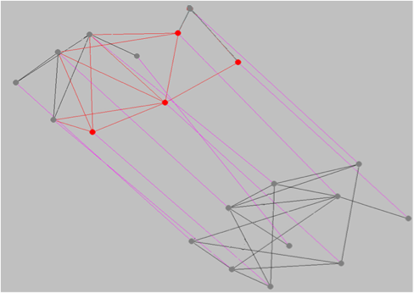
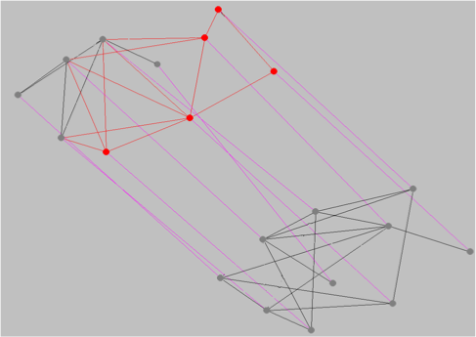
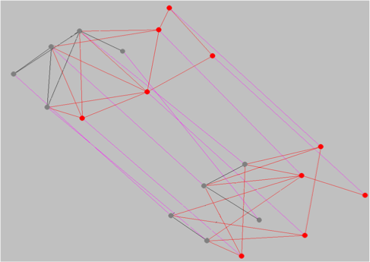
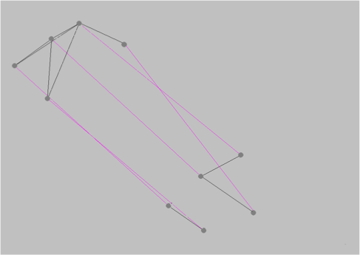
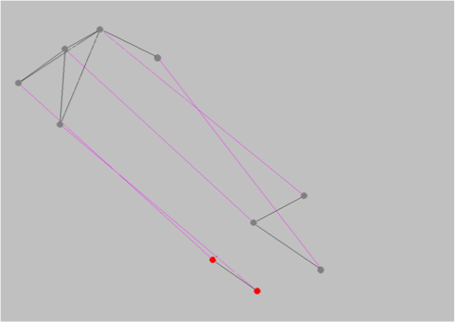
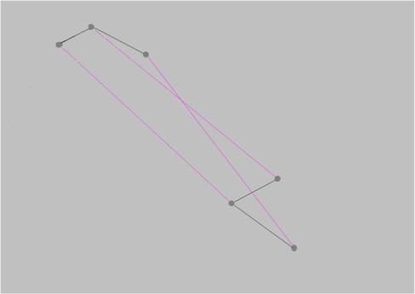
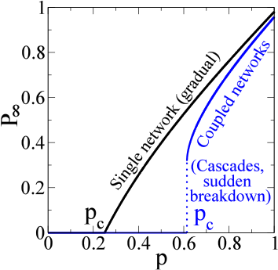
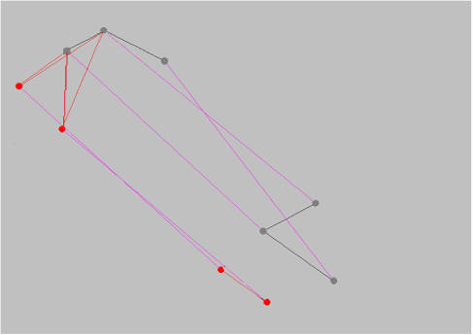


I: Cascading failures in interdependent networks
Interdependent networks model:
Nature 464, 1025 (2010)
connectivity links （grey) + dependency links (purple)
Two types of node failure:
nodes disconnected from the largest cluster in one network.
nodes’ corresponding dependent nodes in the other network fail.
Notes:
In 2010, Sergey, Shlomo and gene proposed this interdependent networks model with a corresponding percolation math framework to study the giant component and critical point.
The model is like this:
two networks,
Within one networks, it’s connectivity links, when one node is disconnected with the giant component, it fails.
Between two networks, it’s dependency links, if one node fail in one network, the corresponding node in the other network fails too.
Nodes are one-to-one correspondent,
This paper showed that instead of second order phase transition in single network, coupled networks has a first order phase transition.

Slide 10


I: Cascading failures in interdependent networks
Topic I: Targeted Attack
Nodes do not fail randomly in many cases
  Cases that low degree nodes are easier to fail
1. Highly connected hubs are secured.
2. Well-connected people in social networks are unlikely to leave the group.
  Cases that high degree nodes are easier to fail
1. Intentional attacks. (Cyber attack, assassination.)
2. Traffic nodes with high traffic load is easier to fail.
Develop a mathematical framework for understanding the robustness of interacting networks under targeted attack.
Notes:
Here comes the first part of my research, we extended the model to be more realistic.
The previous model is random attack.
Considering the the situation when the initial failure of nodes are not random. If you think about it, nodes do not fail in many cases in real life if not most cases.

Slide 11
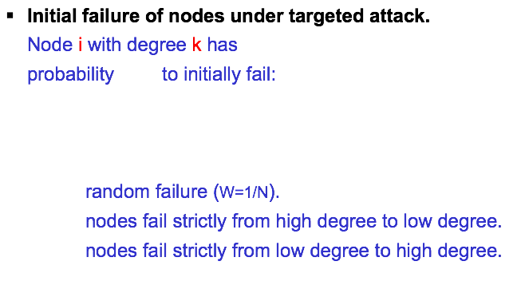

I: Cascading failures in interdependent networks
Topic I: Targeted Attack
Model

Slide 12
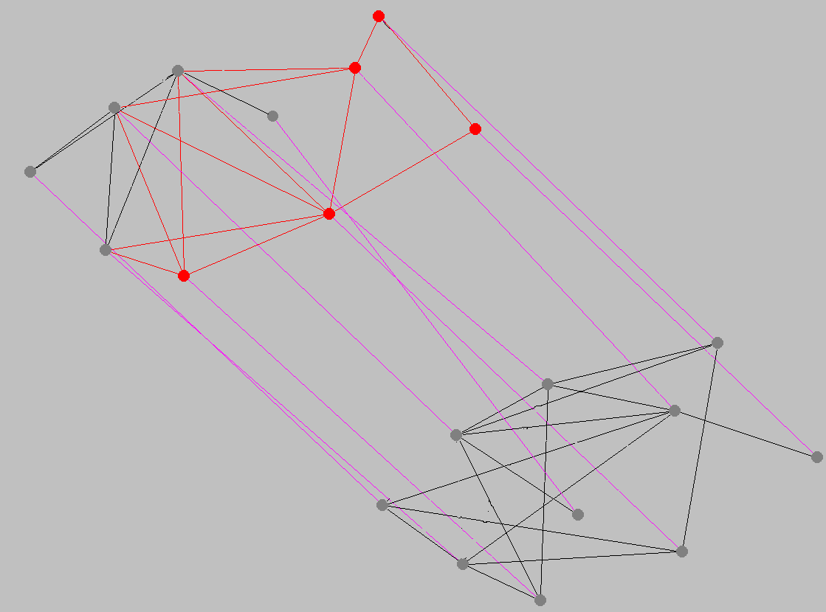
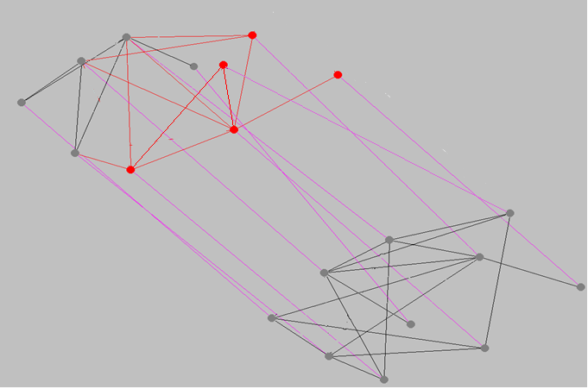
I: Cascading failures in interdependent networks
Topic I: Targeted Attack
Method
Network A
Targeted attack
Network A’
Random failure
Mapping:
Find a network A’, such that the targeted attack problem on interacting networks A and B can be solved as a random failure problem on interacting networks A’ and B.

Slide 13
I: Cascading failures in interdependent networks
Topic I: Targeted Attack
Method
where:

Slide 14
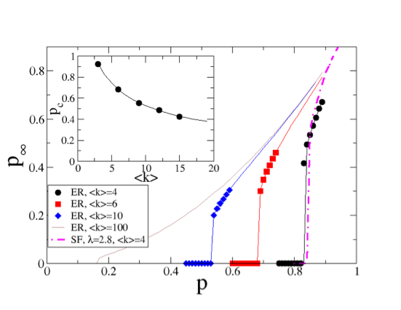
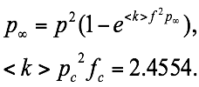

I: Cascading failures in interdependent networks
Topic I: Targeted Attack
Results
ER:
where
random failure:
Notes:
So I did some math excises, and here is the analytical solution of giant component and critical point of targeted attack.

Slide 15
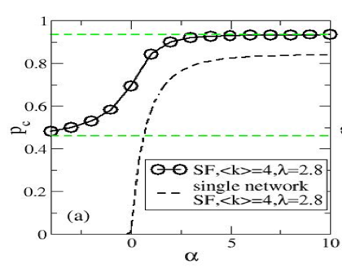
I: Cascading failures in interdependent networks
Topic I: Targeted Attack
Results
Scale Free network:
Low degree nodes in one network can depend and support high degree nodes in the other network.
Notes:
So I did some math excises, and here is the analytical solution of giant component and critical point of targeted attack.

Slide 16
Outline
Cascading failures in interdependent networks
  Topic I: targeted attack
  Topic II: clustering
  Conclusion
Cascading failures in financial systems
  Bipartite networks model for banking system
  Conclusion

Slide 17
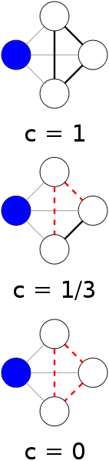
I: Cascading failures in interdependent networks
Topic II: Effect of clustering
model
Random network model: tree-like.
Reality: clustered! Non tree-like.
Clustering:
Whether your friends are each other’s friends.
Notes:
Then let me introduce my work on how clustering affects the percolation of interdependent networks.
Clustering describes whether your friends are friends to each other. It is defined as the pairs of connected neighbors over the total possible pairs of connected neighbors.
Our ability to calculate the properties of random graphs rests on the fact that they are “locally tree-like,” i.e., that they contain no short loops in their structure.
The previous analytical methods are based on the idea of branching process. This approach works well when the networks is locally tree like and thus the clustering coefficient is very small. Real networks, however, are shown to have a significant level of clustering that may change the percolation properties significantly.

Slide 18
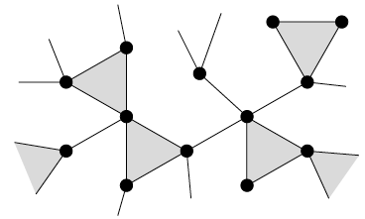


I: Cascading failures in interdependent networks
Topic II: Effect of clustering
Model
Clustered random network model:
e.g. when
Notes:
It randomly assign the number of single links and number of triangles to each node, then connect the links and triangles together randomly.

Slide 19

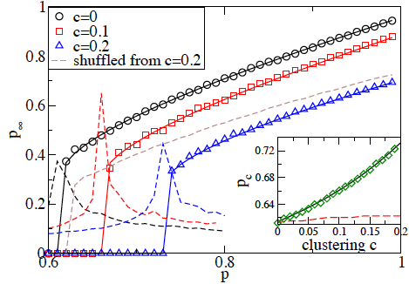
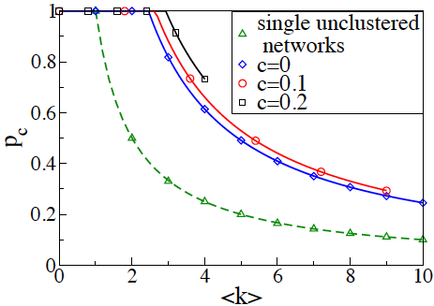

I: Cascading failures in interdependent networks
Topic II: Effect of clustering
Results
2.68
2.45
2.93
ER network
1
Triangles that give the network its clustering contain redundant edges
that serve no purpose in connecting the giant component together.

Slide 20
I: Cascading failures in interdependent networks
Conclusions:
We tried to develop analytical framework to extend the interdependent networks model to more realistic features.
We developed “mapping method” for calculating the giant component and critical point of interdependent networks under targeted attack.
Theoretically studied how clustering affects the percolation of interdependent networks.
-- clustering pushes the critical point of interdependent networks to the right (more fragile)

Slide 21
Outline
Cascading failures in interdependent networks
  Topic I: targeted attack
  Topic II: clustering
  Conclusion
Cascading failures in financial systems
  Bipartite networks model for banking system
  Conclusion

Slide 22
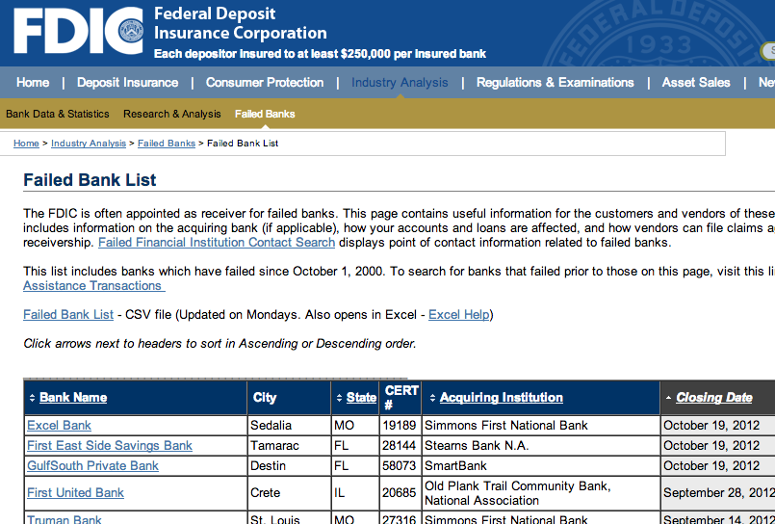
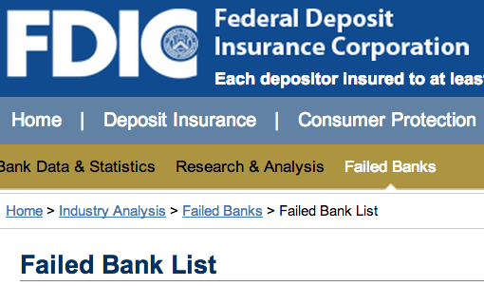
II: Cascading failures in financial system
Apply complex networks to model and study the systemic risk of financial systems.
Btw 2000 ~ 2007:
29 banks failed.
Btw 2007 ~ present:
469 banks failed.
Notes:
2013: 5 banks failed; 2012: 51 banks failed; 2011: 91 banks failed; 2010: 155 banks failed; 2009: 140 banks failed; 2008: 25 banks failed; 2000-2007: 27 banks failed
The other direction of my research is to apply complex networks to model and study financial complex systems.
Federal Deposit Insurance Corporation listed a failed bank list online.
We found that btw 2000 - 2007, only 29 commercial banks failed. while btw 2007-present, 469 commercial banks failed.
2008 financial crisis is very unfortunate to the country and economy. But it is fortunate for researchers. It’s like a big real experiment, which enables us to study the system better and test our models.

Slide 23
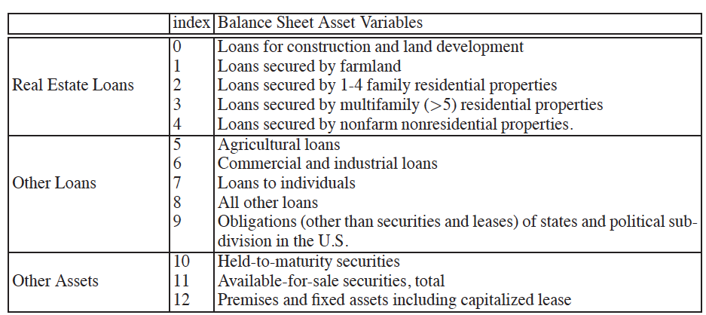
II: Cascading failures in financial system
Data:
1. Commercial Banks - Balance Sheet Data from
Wharton Research Data Services.
  for year 2007
  more than 7000 banks per year
  each bank contains 13 types of assets
    e.g.
    Loans for construction and land development,
    Loans secured by 1-4 family residential properties,
    Agriculture loans.
2. Failed Bank List from the Federal Deposit Insurance Corporation.
In 2008–2011: 371 commercial banks failed.
Notes:
The general idea is to construct the bank network with 2007 data and run the cascading failure test and predict the failed banks. Then compare these failed banks to the real failed banks to see if the model captures the reality.

Slide 24
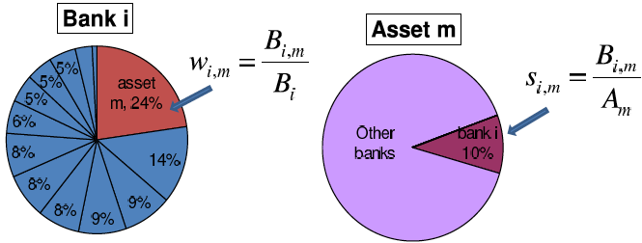
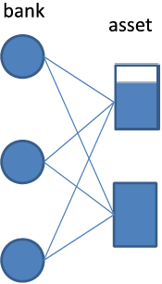
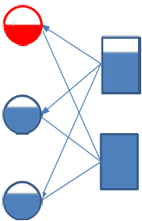
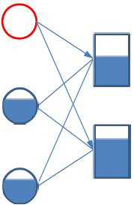
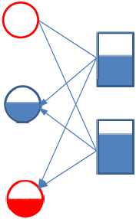
II: Cascading failures in financial system
Bipartite Model
Notes:
Banks are interconnected in many ways, i.e. interbank loans. We only consider the liquidity risk. Which means, when a bank can’t meet its liability and fails, it needs to sell its assets to meet the liability. If the market can’t absorb the sale, then the value of this asset will decrease for a period.
Simulate the model with real data.

Slide 25
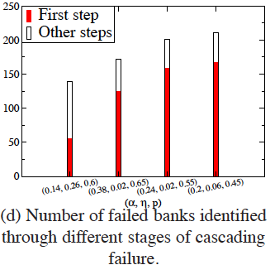
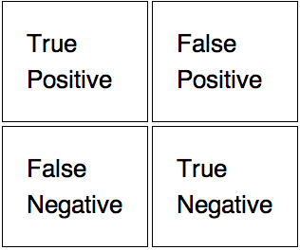
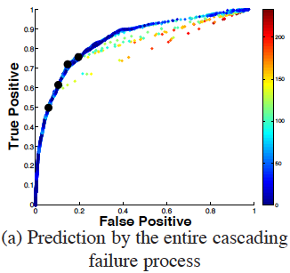
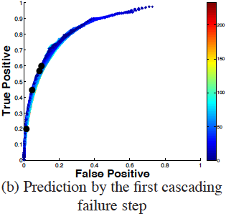
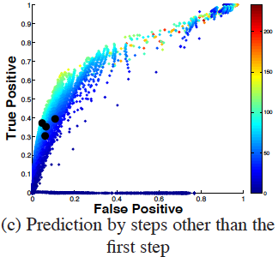
II: Cascading failures in financial system
Receiver operating characteristic(ROC) curve
Results
reality
fail
survive
fail
prediction
outcome
survive
Notes:
We initially give a shock to the loans for … and plot a receiver operating characteristic curve to the prediction of model.
ROC curve is a plot of true positive vs false positive.
True positive rate: fraction of real failed banks identified by the model.
False positive rate: fraction of survived banks in reality but are identified as failed by the model.
When the prediction is random, ROC curve is a diagonal line.
This roc curve shows that the model has good predictive power. For example this point…
Our model can efficiently identify the failed banks in reality.
Complexity of the system does contribute to the failure of banks.

Slide 26
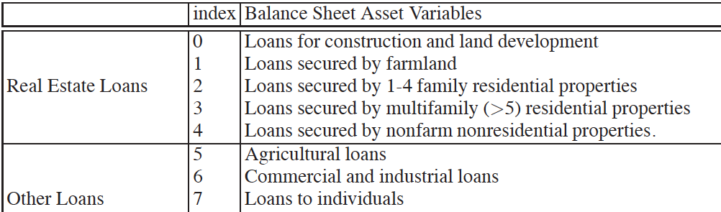
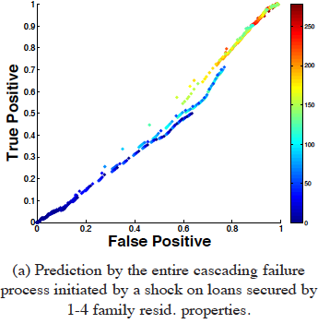
II: Cascading failures in financial system
Commercial real estate loans caused commercial banks failure!
“commercial real estate investments do an excellent job in explaining the failures of banks that were closed during 2009 … we do not find that residential mortgage-backed securities played a significant role…”
-- Journal of Financial Services Research, Forthcoming.
Available at SSRN: http://ssrn.com/abstract=1644983
Notes:
The course of the failure of the commercial banks during the financial crisis are related to business real estate loans, but not the other loans, including the resident real estate loans.

Slide 27
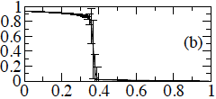
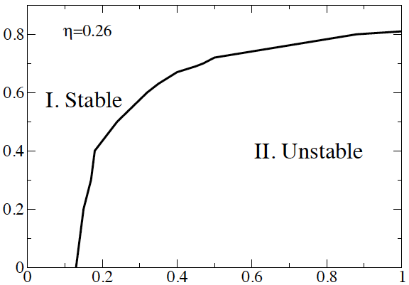


II: Cascading failures in financial system
Results
Sharp phase transition
Stable region
and
unstable region
Notes:
2008 financial crisis is very unfortunate to the country and economy. But it is fortunate for researchers. It’s like a big real experiment, which enables us to study the system better and test our models.

Slide 28
II: Cascading failures in financial system
Conclusion:
Complex network model can efficiently identify the failed commercial banks in financial crisis. (capable of doing stress test).
Complexity of the system does contribute to the failure of banks.
Commercial real estate loans caused commercial banks failure during the financial crisis.
When parameters change, the system can be in stable or unstable regions, which might be helpful to policymakers.
[ Scientific Reports, 3, 1219 (2013) ]
Notes:
2008 financial crisis is very unfortunate to the country and economy. But it is fortunate for researchers. It’s like a big real experiment, which enables us to study the system better and test our models.

Slide 29
Thank you!
Notes:
2008 financial crisis is very unfortunate to the country and economy. But it is fortunate for researchers. It’s like a big real experiment, which enables us to study the system better and test our models.

Slide 30
How to find network A’? (continued)
Network A
Random attack (1-p)
Network A’
Interim network
Targeted attack (1-p)
Notes:
Mathematically, from GA0, we can calculate the generating function of the interim network, and then back to calculate the generating function of network A’.
After we have network A’, we can apply the same framework developed by Nature paper to solve the targeted attack problems.

Slide 31
Targeted attack, (1-p) fraction
Network A
Stage a
Stage b
Stage c
where
Network A’
Random failure, (1-p) fraction
Physical Review E 66, 016128 (2002)

